Slide 1
9-26-19
Dear Families,
Welcome to Open House at Duzine Elementary School! Tonight, you will be learning about the second grade program. We ask that any student specific information that needs to be discussed be done during a more private time rather than tonight.
Please take some time to look around the room. Your children have been working hard on many different projects.
Please fill out the forms that are on your child’s desk and leave them. We will collect them at the end of the night.
We hope you have a great night!
Lisa Hasbrouck and Michele Favale

Slide 2
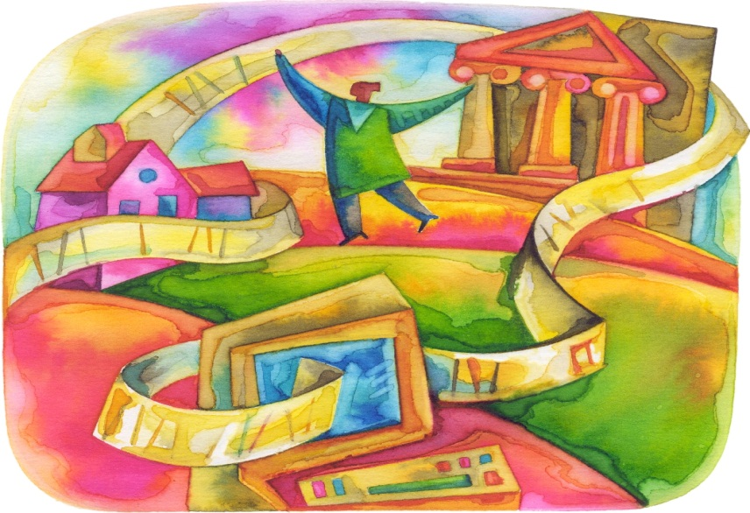
Welcome!
Open House 2019
Second Grade
Michele Favale
Lisa Hasbrouck

Slide 3
Parent Conferences
Please sign-up
15 minutes each
December 2, 2019
(no school for students)
December 3, 2019
(3:45-6:00pm)

Slide 4
Morning Meeting
Friendly Greeting
Morning Message
Sharing
Activity/Game

Slide 5
Special Schedule
A Day-P.E. 2:20-3:00
B Day-P.E. 2:20-3:00
C Day-P.E. 2:20-3:00
D Day-Art 2:20-3:00
E Day-Music 2:20-3:00
F Day-P.E. 2:20-3:00
B,D,F Days- Spanish 11:25-11:45
Every A Day- Library 10:35-11:15
1 x monthly- C Day– Mental Health Lessons by our school social worker and or school psychologist.

Slide 6
Reading/Writing/Math
Workshops
Mini lesson
Guided Practice
Independent Work
Challenge work
Share out

Slide 7
Social Studies and Science
Duzine is integrating social studies and science into
project based models. Many areas of study will be webbed
throughout the curriculum. Some of the topics are…
Community
Social justice
Maps
Animals/Ecosystems/Plants
Healthy and safety
Weather

Slide 8


Birthdays
Birthdays- If you need to send invitations to school
be sure you have sent one for each child in class.
We sent home a class directory so you
can mail invitations to specific children if you are
not inviting every child. You do not have to invite
every child.
Birthday Celebrations- If you would like to send in
a special treat to celebrate your child’s birthday
please let us know in advance and be sure it is in
school before snack. We will enjoy it during our
regular snack time. It can be dropped off at the
front desk anytime before snack (before 2:00pm).

Slide 9
Other Information
Folders
Sneakers are required for Physical Education class.
Pick up notes and bus passes

Slide 10


Slide 11
Let’s have a great year!
Thank you for joining us!
mfavale@newpaltz.k12.ny.us
lhasbrouck@newpaltz.k12.ny.us

